Slide 1
AS91896(2.7) & AS91887(2.8) Documentation
Jonty van der Colff

Slide 2
[Overtype this with your program name]
Link to GitHub Repository: jonvdc/2.7-and-2.8-Assessment (github.com)
Links to Trello board / project management tools: Monster Card Catalogue | Trello
Link to final version of your program:
Ensure you have made these links ‘public’ so that they are open to anyone, including the marker. The link to your program is the final outcome of this whole project – your finished program.

Slide 3
Explain relevant Implications:
Additional rows can be added by clicking in the last cell and then using the Tab key
Relevant implication | Explain the implication and say how it is relevant to this project
Functionality | Functionality is making ensuring that a program works. If a program is functional, then it does what the developer created it do, and works as expected. If a program is not functional, then the program does not serve it’s purpose, or doesn’t/can’t do what it was created to do.
Usability | Usability is about how easily the end user can get the program to do what it is required to do. If there is a problem, or the program does not know what to do, then the program will display an easy to read and/or notice error message, telling the user exactly what is wrong, or why the user can’t perform that particular action.
Aesthetics | Aesthetics is about the programs overall appearance. A program with well spaced instructions and ‘decorations’ around text boxes and/or borders will be easier to read and follow then one with plain text and borders.
Notes:
Additional rows can be added by clicking in the last cell and then using the Tab key

Slide 4
Explain relevant Implications:
Additional rows can be added by clicking in the last cell and then using the Tab key
Relevant implication | Explain the implication and say how it is relevant to this project
Social | The social implications of a computer program are about how the program might have an effect on the users/society. For example, a program promoting gambling might have a negative effect on users, as the program might start a long-term gambling addiction that will eventually lead to the user becoming broke, and losing their social status.
Future proofing | Future proofing is about making a program easier to modify if there proves to be any error in the code later. For example, one developer might see a problem that will come up later, and therefore leave a note so that they or one of their colleagues can come back and fix it later.
Notes:
Additional rows can be added by clicking in the last cell and then using the Tab key

Slide 5
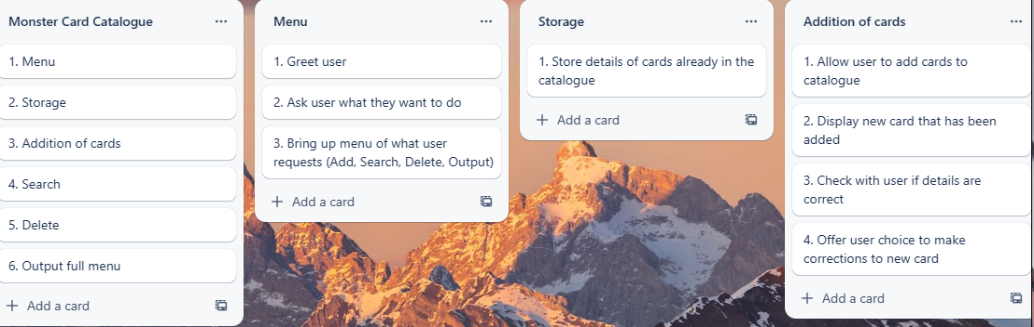
Decomposition:
Paste screenshots of your initial Trello board / task decomposition on this slide. If you have a long list, you might need to break it up into several slides.
Notes:
Paste screenshots of your initial Trello board / task decomposition on this slide. If you have a long list, you might need to break it up into several slides.

Slide 6
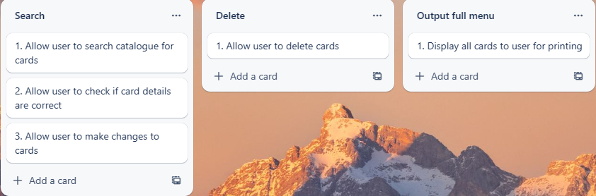
Decomposition:
Paste screenshots of your initial Trello board / task decomposition on this slide. If you have a long list, you might need to break it up into several slides.
Notes:
Paste screenshots of your initial Trello board / task decomposition on this slide. If you have a long list, you might need to break it up into several slides.

Slide 7
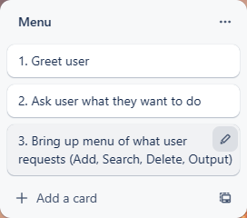
[Menu] (Trello screenshot)

Slide 8
[Component name] - Test Plan
Additional rows can be added by clicking in the last cell and then using the Tab key
Test Cases - input | Expected output
Notes:
Additional rows can be added by clicking in the last cell and then using the Tab key

Slide 9
[Component name]: Trialling
NOTE: Trialling needs to happen for at least 2 of your components but is not necessary for ALL components.
Trialling is not the same as testing. Trialling is about finding different ways of building the same component. Show evidence of your trialling here. Select one of your trials for further development and give reasons for your choice.
Notes:
NOTE: Trialling needs to happen for at least 2 of your components but is not necessary for ALL components.
Trialling is not the same as testing. Trialling is about finding different ways of building the same component. Show evidence of your trialling here. Select one of your trials for further development and give reasons for your choice.

Slide 10
[Component name]: Testing
You must show the results of testing. For each component, include a screenshot proving it works. You can also include notes about each test.
Notes:
You must show the results of testing. For each component, include a screenshot proving it works. You can also include notes about each test.

Slide 11
Assembled Outcome Testing:
Show testing for your assembled outcome below. This should include a test plan followed by screenshot proof.
Notes:
Show testing for your assembled outcome below. This should include a test plan followed by screenshot proof.

Slide 12
Address relevant Implications:
Relevant implication | Explain how your final outcome addresses each implication

Slide 13
Version Control Evidence:
Your version control evidence should go here. This could be in the form of screenshots (both of your GitHub repository as well as your local project folder) as evidence of your incremental development.
Notes:
Your version control evidence should go here. This could be in the form of screenshots (both of your GitHub repository as well as your local project folder) as evidence of your incremental development.

Slide 14
Final Discussion:
Discuss how the information from planning, testing and trialling of components assisted in the development of a high-quality outcome.
Notes:
Discuss how the information from planning, testing and trialling of components assisted in the development of a high-quality outcome.

